Slide 1
QI-Research SIG
The Fundamentals
Richard K. Sterling, MD, MSC, FACP, AGAF, FAASLD
Professor of Hepatology
Chief of Hepatology
Associate Program Director for Scholarship and Research
Assistant Chair for Research
Medical Director, Viral Hepatitis and HIV Liver Clinic
Georgia McIntosh, MD
Associate Professor
Division Hospital Medicine
Associate Chair, Quality and Safety

Slide 2
Objectives
What is QI? How did it start?
How do I start?
What QI models are there?
How is QI different from research?
Do I need to submit to the PROC?
Do I need to submit to the IRB?

Slide 3

What is QI?
Standardized processes and structure to
  Reduce variation
  Achieve predicable results
  Improve outcomes for patients, healthcare systems, and organizations
Application of known knowledge
No additional risk

Slide 4

Safety and Quality Movement
Improvement efforts began in early days of Medicare
Dr. Avedis Donabedian, physician- 1966, published the current basis to evaluate healthcare quality: structure, process & outcomes
IOM- “To Err Is Human”, published 1999
Health care in the US is not as safe as it should be…and can be

Slide 5

Safety and Quality Movement
IOM- “Crossing the Quality Chasm”, published 2001
US health care system does not provide consistent, high-quality medical care to all people
Between the healthcare that we have now and the healthcare that we could have lies not just a gap…but a chasm

Slide 6
QI helps bridge the gap
Gap
Practice
Knowledge

Slide 7
IOMs 6 Principles of Quality Care (STEEEP)
Safe- wrong-site surgeries, medication errors
Timely- ED wait time, delay recognizing critical illness
Effective- Thoughtful use of antibiotics, DVT ppx
Efficient- lack of geographic admissions
Equitable- same care regardless of gender, ethnicity, SES, geographic location
Patient-centered- respectful and responsive to individual patient needs, preferences, values

Slide 8
6 Steps to QI
Understand the problem, identify your stakeholders & team
Identify areas for change/improvement
Explicitly state your goals
How will you measure progress
Create effective, reliable improvements
Build upon success and sustain the process

Slide 9
Example grid of stakeholders
Subjects
Patients
Caregivers
Providers
Players
Medical director
Nurse Manager
Nurses
high
Interest
Crowd
Trainees
Students
Consultants
Context Setters
Hospital Leadership
Support Groups
Societies
Government Organizations
low
low
POWER
high

Slide 10
QI Teams
Team leader/champion
  Day to day management
Technical experts
  Understand the different components
Clinical/system leader
  How the change will impact other systems
Improvement advisor
  Expertise in QI methods
Executive sponsor
  Power to make the change
Process owner
  Responsible for sustainability

Slide 11
QI Methodologies
 | Six Sigma | Lean | Model for Improvement
Origin | Motorola 1980s | Toyota 1950s | Associates in Progress Improvement 1990s
Philosophy | Continuous improvement Reduce unwanted variability | Continuous improvement Staff respect and empowerment | Daily improvement, small scale, rapid cycle
Approach | 5-phases (define, measure, analyze, improve, and control) | Identify waste to eliminate it | Set aim, create balance measures, test changes
Common tools | Mathematical modeling, cycles, charts, PDSA cycles | Flow diagrams, charts, PDSA cycles | Charts, PDSA cycles
Training | Quantitative statistics, experience | Apprenticeships, experience | Experience
Project length | Months | Weeks to months | Days to weeks
Limitations | Complex, not accessible for frontline staff, not good for projects that focus on speed and throughput | Not ideal for projects focused on statistical control and reducing variation | Tools and change ideas adapted from other frameworks
Applications | Cause of variation unknown, no solution exists | Good for directly observed problems, increase speed and flow | Know the problem and ideas to change are easily identified, evidence-based
*PDSA: Plan-Do-Study-Act
Silver et al. CJASN 2016

Slide 12
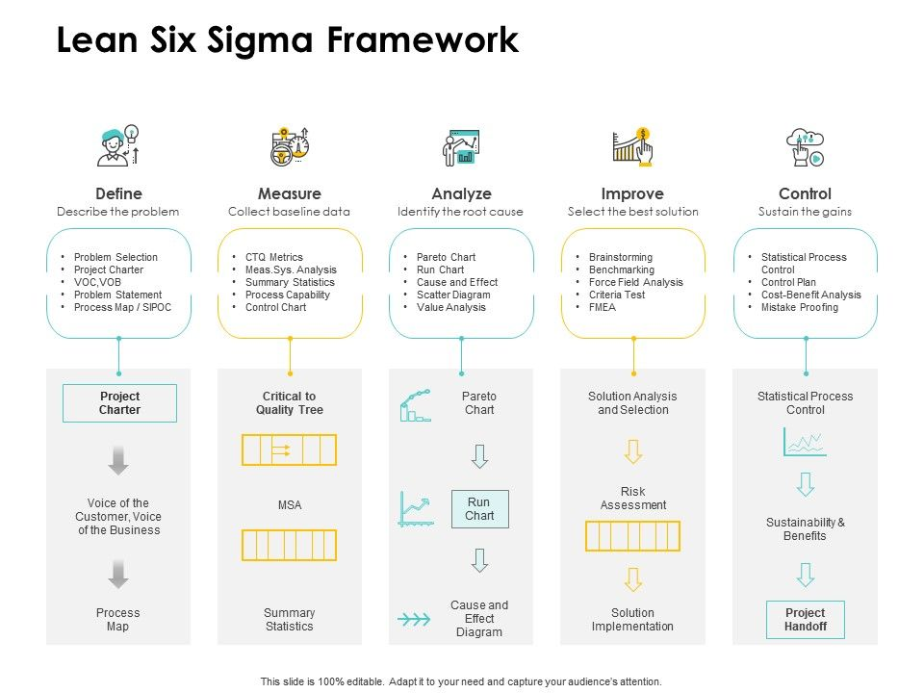

Slide 13
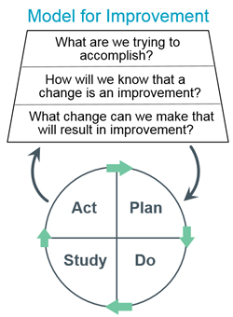
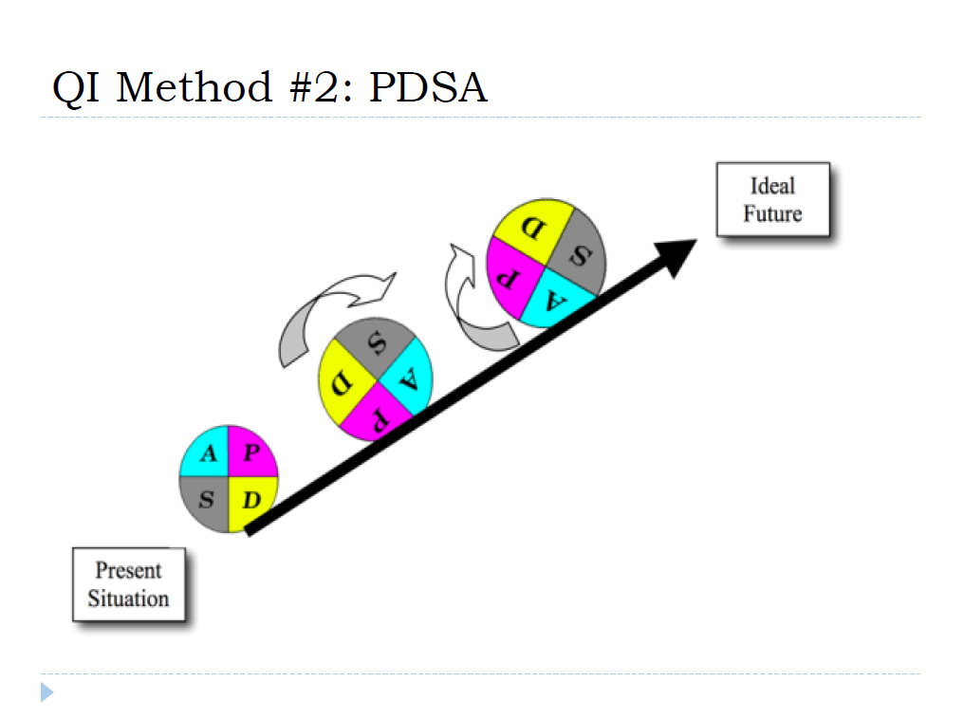

Slide 14
Model for Improvement- PDSA Cycle
Plan
  State the objectives
  Make predictions
  Develop the measures and plan to carry out the cycle
Do
  Carry out the test
  Document problems and unexpected observations (defects)
  Begin to analyze the data
Study
  Summarize what was learned, what went right, what went wrong
Act
  Determine what changes need to be made
Varkey et al. Mayo Clin Proc 2007

Slide 15
Common themes among the methodologies
Leadership
Measurement
Staff involvement
Team approach
Patient focused

Slide 16
Where to get inspiration for a QI project
Colleagues
Experiences
Complaints
Significant events and near misses (Root cause analysis)
Social media
Latest guidelines

Slide 17
What you need to start
Clear aim
  For whom
  How good
  By when
Measurables
  What is the improvement outcome
  Outcomes, process and balancing measures (unintended consequences)
Stretchable
  Identifies that the current situation is not working
  Can be ambitious, but understand cannot fix all the problems

Slide 18
Aim Statement
S = Specific- what specific process do you want to improve
M= Measurable- what metric will you use
A = Achievable- what time frame, your capacity
R = Relevant/Realistic- is it important to others
T = Time-bound- can you get it done

Slide 19
How to write a SMART GOAL
There are many ways to structure your SMART GOALs. Below are some examples:
[Who] will do [what] resulting in [measure] by [when].
2. By [when], [who] will do [what] resulting in [measure].
3.By [when], [measure - includes who and what].
4.[Measure – includes who and what] by [when].
Taken from: Public Health & QI Toolbox: SMART Objectives.

Slide 20
Donabedian’s Topology of Quality Measures
  Structure- How was care delivered to the patient
  Process- What was done to the patient
  Outcome- What happened to the patient
  **Balancing- Unintended, undesirable consequences
Notes:
Structure- what can you buy, build or hire
Process- acts of care
Outcomes- impact on the patient

Slide 21
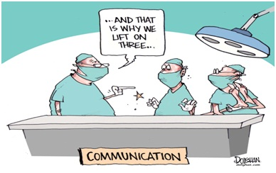
SQUIRE Guidelines
Standards for QUality Improvement Reporting Excellence (SQUIRE)
  Support scholarly publication of healthcare improvement work, esp. reports that…
    Describe system level work to improve the quality, safety, and value of healthcare
    Used methods to establish that observed outcomes were due to the interventions.
  Provide framework for reporting new knowledge about how to improve healthcare
    Address variation in in content and quality
    Increase completeness and transparency
  Encourage reporting of negative studies
Initial guidelines (SQUIRE 1.0, 2008)
Updated guidelines (SQUIRE 2.0, 2015)
Goodman D, Ogrinc G, Davies L, et al. (2016). Explanation and elaboration of the SQUIRE (Standards for Quality Improvement Reporting Excellence) Guidelines, V. 2.0: examples of SQUIRE elements in the healthcare improvement literature. BMJ quality & safety, bmjqs-2015.

Slide 22
SQUIRE 2.0 Overview
Section | Subsections
Title and Abstract | Title, Abstract
Introduction | Problem Description, Available Knowledge, Rationale, Specific Aims
Methods | Context, Intervention(s), Study of the Intervention(s), Measures, Analysis, Ethical Considerations
Results | Results
Discussion | Summary, Interpretation, Limitations, Conclusions
Other Information | Funding

Slide 23
QI vs. Research
QI
  Address the need of a local situation
  Use data-driven methods to improve health delivery and quality (the process)
Research
  Systematic investigation
  Address problems that are more generalizable
QI = Research when
  The tested intervention is not standard practice
  Involves individual subjects
  Randomizes or blinding is used
  Subjects had additional risks or burden
  Results are generalizable
Bass et al. Ochsner Journal 2020

Slide 24
How to determine if QI or research
Does the activity involve research (45 CFR§46.102(d))?
Are human subjects involved (45 CFR§46.102(f))?
Does the research qualify for an exemption under 45 CFR§46.102(b)?
Is the project nonexempt human subjects research?

Slide 25
What the heck is 45 CFR§46.102?
A human subject is defined as a “living individual about whom an investigator, whether professional or student, conducting research:
  Obtains information or biospecimens through intervention or interaction with the individual, and uses, studies, or analyzes the information or biospecimen
  Obtains, uses, studies, analyzes, or generates identifiable private information or identifiable biospecimens
  Designed to develop or contribute to generalizable knowledge.

Slide 26
What types of projects may be exempt from IRB?
Established educational practices
Educational tests or surveys
Existing de-identified data or biospecimens
Public benefit or service program evaluations
Taste and food quality
Medical record reviews to generate de-identified data
Non-human subjects research

Slide 27
Non-Human subjects research
Data collected for internal use only
General information about policies and procedures
Oral history that is not generalizable beyond an individual
Independent contracts for cost-benefit analyses of customer satisfaction
Research on cadavers, autopsy materials, or specimens from deceased
QI projects that are not generalizable
Case reports
Publicly available data

Slide 28
How do you decide if QI or research?
Do I intend this project to lead to generalizable knowledge?
Will I use PDSA or only look at the data at the end?
Will the project lead to a change in local practice?
Will the project improve the local process?
Is there a protocol, intervention, control group?
Is there external funding?
Is the process evidenced based or am I generating new data?
Is there any risk to the subjects (other than privacy)?

Slide 29
Research vs. QI
 | Research | Quality Improvement
Purpose | Develop or contribute to generalizable knowledge | Apply research in practice; to improve internal processes and practice
Method | One large blind test | Many sequential, observable tests
Risk | May place subjects at risk | Does not increase risk to patients (except possible privacy/confidentiality)
Protocol | Formal and rigid protocol with tight controls; unchanged throughout the research | Adaptive, iterative design
Measurement | Complete, accurate, controlled | Gather “just enough” data to learn and complete another cycle of improvement
Primary Audience | Scientific community | Local organization

Slide 30
Limitations to QI Approach: Organizations
QI methodology may not always allow for adequate evaluation of intervention and outcomes, for example:
  Complex, multicomponent interventions
  Unclear how much differences in patient severity accounted for results
  Full impact on the cost of care could not be evaluated
  Hawthorne effect may have caused improvements more so than the initiative
  Lack of generalizability because of small sample size
Impact on QI initiative
  Skepticism of colleagues, lack of buy-in
  Lack of support and resources from leadership
  Lack of reproducibility within an organization
  Unable to evaluate success of initiative, determine next steps
Hughes RG. Tools and Strategies for Quality Improvement and Patient Safety. In: Hughes RG, editor. Patient Safety and Quality: An Evidence-Based Handbook for Nurses. Rockville (MD): Agency for Healthcare Research and Quality (US); 2008 Apr. Chapter 44. Available from: https://www.ncbi.nlm.nih.gov/books/NBK2682/

Slide 31
The process at VCU
Start with your idea
Determine if QI or research (or both)
Develop the plan, team, tools, data management, etc
Submit to the PROC (designate QI or research)
PROC will help decide if need to submit to IRB

Slide 32
Appendix

Slide 33
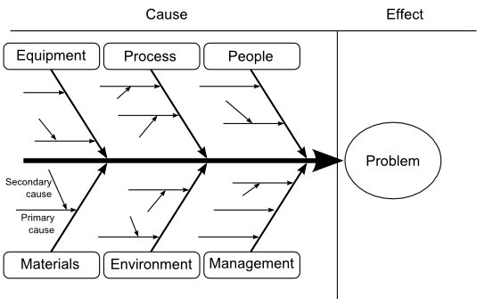
Process Modeling Tools
Cause and effect diagram ( “fishbone or Ishikawa”)

Slide 34
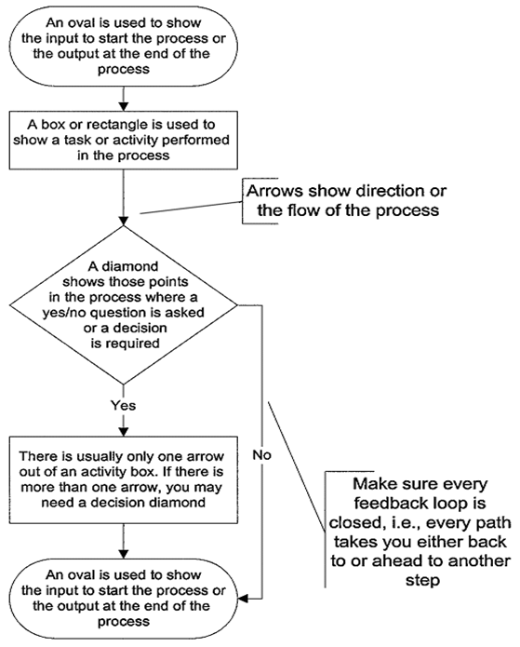
Process Modeling Tools
Process Map

Slide 35
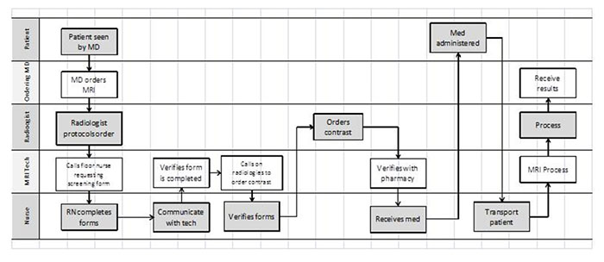
Process Modeling Tools
Deployment Flowchart or Swim-lane Diagram

Slide 36
